Slide 1
OBESITY PROJECT
A PROJECT TO PREDICT THE OBESITY LEVELS IN HUMANS

Slide 2
INTRODUCTION
Obesity is a medical condition characterized by excessive or abnormal accumulation of body fat that poses health risks. It is typically determined by measuring an individual's body mass index (BMI), which is calculated using their weight and height. Obesity is associated with various negative health effects, including an increased risk of developing chronic conditions such as diabetes, heart disease, certain cancers, and musculoskeletal disorders. Factors contributing to obesity include a combination of genetic, environmental, behavioral, and socioeconomic influences. Effective management and prevention of obesity involve lifestyle modifications, including a balanced diet, regular physical activity, behavior changes, and, in some cases, medical interventions.
Details on the dataset.
This dataset include data for the estimation of obesity levels in individuals from the countries of Mexico, Peru and Colombia, based on their eating habits and physical condition. The data contains 17 attributes and 2111 records, the records are labeled with the class variable NObesity (Obesity Level), that allows classification of the data using the values of Insufficient Weight, Normal Weight, Overweight Level I, Overweight Level II, Obesity Type I, Obesity Type II and Obesity Type III. 77% of the data was generated synthetically using the Weka tool and the SMOTE filter, 23% of the data was collected directly from users through a web platform.
source
https://www.sciencedirect.com/science/article/pii/S2352340919306985?via%3Dihub

Slide 3
The columns in the "ObesityDataSet_raw_and_data_sinthetic.csv" dataset are described as follows:
'Gender': Represents the gender of the individual (Male/Female).
'Age': Indicates the age of the individual in years.
'Height': Specifies the height of the individual in centimeters.
'Weight': Represents the weight of the individual in kilograms.
'family_history_with_overweight': Indicates whether the individual has a family history of overweight (Yes/No).
'FAVC': Represents whether the individual consumes high-calorie food frequently (Yes/No).
'FCVC': Indicates the frequency of consumption of vegetables by the individual (ranging from 1 to 3).
'NCP': Represents the number of main meals consumed by the individual per day (ranging from 1 to 3).
'CAEC': Represents the frequency of consumption of food between meals by the individual (ranging from 0 to 3).
'SMOKE': Indicates whether the individual is a smoker or not (Yes/No).
'CH2O': Represents the daily water intake of the individual in liters.
'SCC': Indicates whether the individual monitors the number of calories consumed (Yes/No).
'FAF': Represents the frequency of physical activity by the individual (ranging from 0 to 3).
'TUE': Indicates the time spent using electronic devices per day in hours.
'CALC': Represents whether the individual follows a special diet or not (Yes/No).
'MTRANS': Indicates the mode of transportation used by the individual (ranging from 1 to 5).
'NObeyesdad': Represents the weight status of the individual based on the WHO BMI classification (ranging from 0 to 6).

Slide 4
1.Import Libraries
Loading the necessary libraries for the project

Slide 5
2. Load the dataset
df = pd.read_csv("ObesityDataSet_raw_and_data_sinthetic.csv")
The data used is from the above link.

Slide 6
3. Exploratory Data Analysis
Data encoding
Here we are doing ordinal encoding which is a technique used to convert categorical variables with an inherent order or rank into numerical representations. It assigns integer values to categories based on their order, preserving the ordinal relationship among them

Slide 7
4. Feature Engineering¶
Correlation
Correlation is a statistical measure that expresses the extent to which two variables are linearly related (meaning they change together at a constant rate). It’s a common tool for describing simple relationships without making a statement about cause and effect. We can determine that there are two types of correlation :
Positive correlation : In positive correlation , if one variable increases then the other variable increases and same if one variable decreases then the other variable decreases. The slope of the fitting line in such a case would be positive.
Negative correlation : In negative correlation , the inverse relationship is there between the correlated variables , that is if one variable increases/decreases then the other variable decreases/increases.

Slide 8
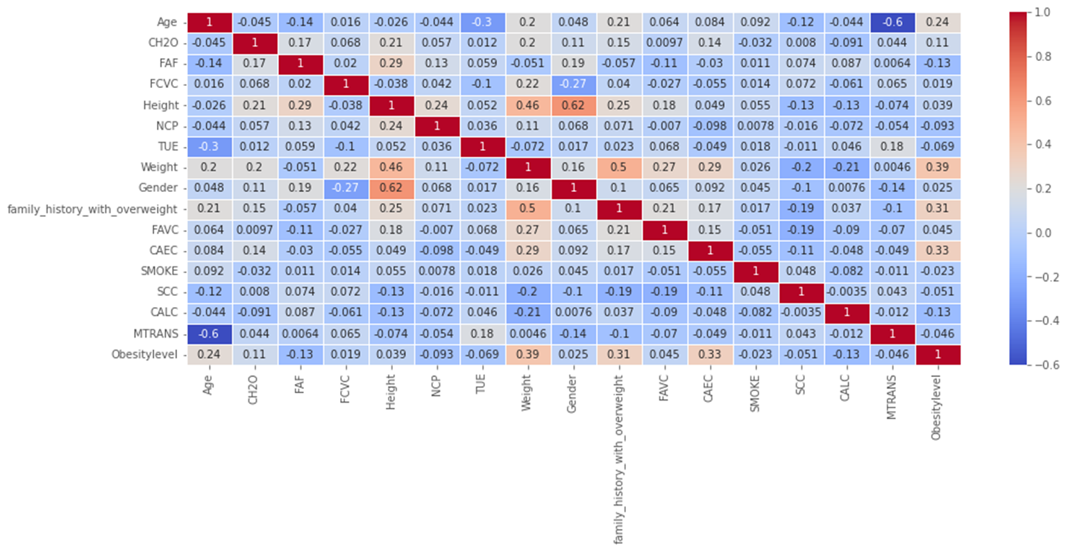
Correlation Matrix

Slide 9
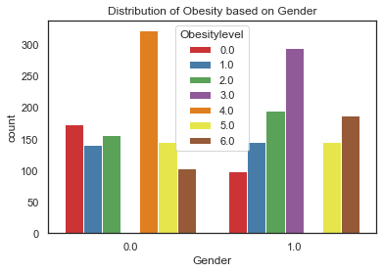
Shows the distribution of obesity based on gender

Slide 10
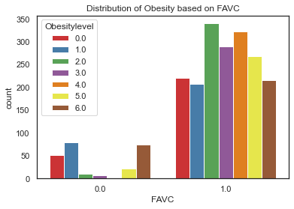
Distribution of obesity based on frequency in consumption of vagetables

Slide 11
The line inbetwen shows that there is a positive correlation between the two variables, which means an increase in one variable leads to an increase in the other. In other words, taller people are more likely to weigh more.

Slide 12
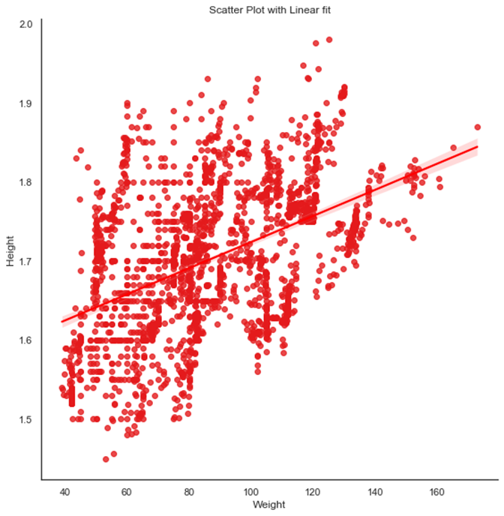
Scaler plot with linear fit

Slide 13
4.Feature selection and engineering
We can now select features based on their strong correlation with the output and remove some input features which are strongly correlated with each other to avoid the problem of multicolinearity. It is a phenomenon in which one predictor variable in a multiple regression model can be linearly predicted from the others with a substantial degree of accuracy.

Slide 14
5.Machine learning modelling
Here the following has been done
Data Splitting: Divide the data into training and testing sets.
Import Libraries: Bring in required libraries, including RandomForestClassifier.
Model Training: Train the RandomForestClassifier using the training data.
Model Prediction: Make predictions on the testing data.
Model Evaluation: Assess the model's performance using evaluation metrics.
Fine-tune hyperparameters, analyze feature importance, and iterate for improvements.
Deploy the final model for real-world predictions.

